Slide 2

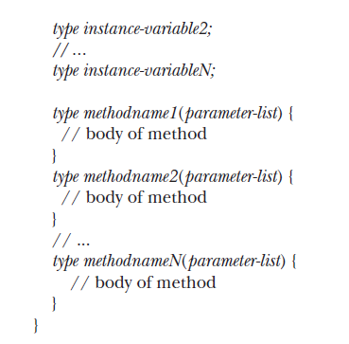
Classes
The General Form of a Class

Slide 3
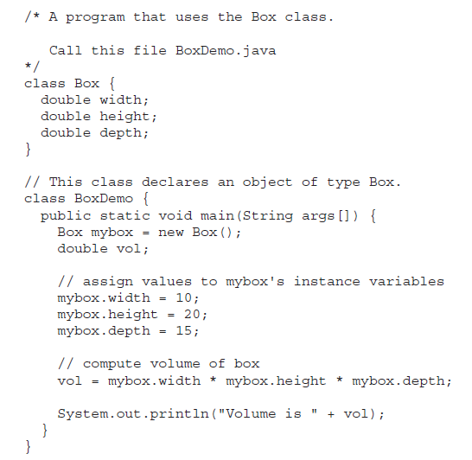
A Simple Class

Slide 4
Method
This is the general form of a method:
type name(parameter-list) {
// body of method
}
form of the return statement:
return value;

Slide 5
// This program includes a method inside the box class.
class Box {
double width;
double height;
double depth;
// display volume of a box
void volume() {
System.out.print("Volume is ");
System.out.println(width * height *depth);
}
}

Slide 6
class BoxDemo3 {
public static void main(String args[]) {
Box mybox1 = new Box();
Box mybox2 = new Box();
// assign values to mybox1's instance variables
mybox1.width = 10;
mybox1.height = 20;
mybox1.depth = 15;
/* assign different values to mybox2's instance variables */
mybox2.width = 3;
mybox2.height = 6;
mybox2.depth = 9;
// display volume of first box
mybox1.volume();
// display volume of second box
mybox2.volume();
}
}

Slide 7
Constructors
/* Here, Box uses a constructor to initialize the dimensions of a box.*/
class Box {
double width;
double height;
double depth;
// This is the constructor for Box.
Box() {
System.out.println("Constructing Box");
width = 10;
height = 10;
depth = 10;
}
// compute and return volume
double volume() {
return width * height * depth;
}
}

Slide 8
Method Overloading
// Demonstrate method overloading.
class OverloadDemo {
void test() {
System.out.println("No parameters");
}
// Overload test for one integer parameter.
void test(int a) {
System.out.println("a: " + a);
}
// Overload test for two integer parameters.
void test(int a, int b) {
System.out.println("a and b: " + a + " " + b);
}
// Overload test for a double parameter
double test(double a) {
System.out.println("double a: " + a);
return a*a;
}
}

Slide 9
class Overload {
public static void main(String args[]) {
OverloadDemo ob = new OverloadDemo();
double result;
// call all versions of test()
ob.test();
ob.test(10);
ob.test(10, 20);
result = ob.test(123.25);
System.out.println("Result of ob.test(123.25): " + result);
}
}

Slide 10
Overloading Constructors
/* Here, Box defines three constructors to initialize the dimensions of a box various ways. */
class Box {
double width;
double height;
double depth;
// constructor used when all dimensions specified
Box(double w, double h, double d) {
width = w;
height = h;
depth = d;
}

Slide 11
// constructor used when no dimensions specified
Box() {
width = -1; // use -1 to indicate
height = -1; // an uninitialized
depth = -1; // box
}
// constructor used when cube is created
Box(double len) {
width = height = depth = len;
}
// compute and return volume
double volume() {
return width * height * depth;
}
}

Slide 12
Box mybox1 = new Box(10, 20, 15);
Box mybox2 = new Box();
Box mycube = new Box(7);

Slide 13
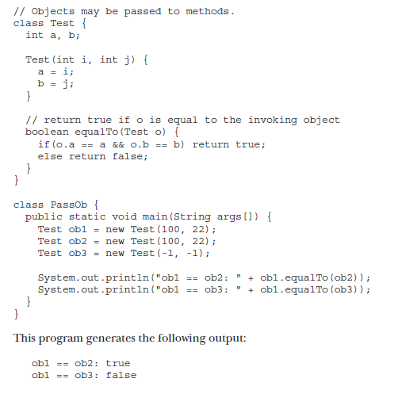
Using Objects as Parameters

